Slide 1



Energy-Constrained Field Operations
DEPARTMENT OF INFORMATICS, BIOENGINEERING ,
ROBOTICS AND SYSTEM ENGINEERING
DIBRIS
UNIVERSITY OF GENOVA
TEAM D8 : Agricultural Robotics
Assignment 5:
ARTIFICIAL INTELLIGENCE FOR ROBOTICS II
Professor :
FULVIO MASTROGIOVANNI
Tutor :
OMAR KASHMAR
Author :
RIADH BAHRI
Student ID:
S8335614
2025 - 2026

Slide 2
PROBLEM & DOMAIN
1

Slide 3
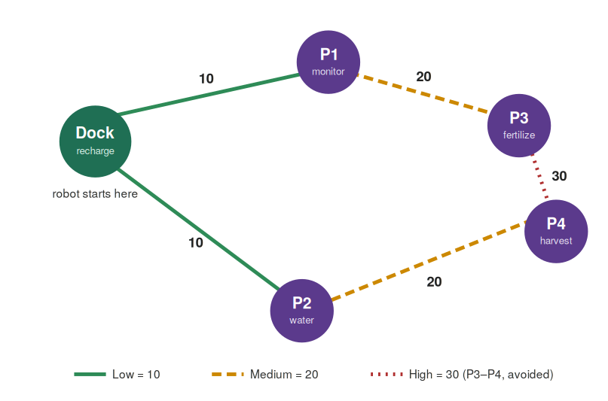




1
2
3
4
1
Problem & Domain
Design choices
Results
Reflections
One robot, four jobs, one battery
A dock (D) and four plots (P1–P4) on a connected graph.
1 – Field
2 - Jobs
Each plot needs one task: monitor, water, fertilize, harvest.
Every move and task drains a 100-unit battery; only the dock recharges.
3 - Energy
Find an action sequence that finishes all jobs without hitting zero.
4 - Goal
The field as a cost graph — edges priced, load added on top.

Slide 4
1
2
3
4
1
Problem & Domain
Design choices
Results
Reflections
Two models of the same field
Both models plan on the same field; they differ only in how energy is counted.
Q1 — Discrete (PDDL)
Q2 — Continuous (PDDL+)
Energy is a number that drops one jump per action.
Recharge is instant (assign to full).
Move cost = edge cost + current load.
Operations change the load: water/fertilize −5, harvest +5.
Fast, easy to verify by hand.
Energy drains over time via processes.
Recharge takes real seconds — the robot waits.
Move cost = Δt × (terrain rate + load).
Start/stop actions with a timer make duration matter.
Events guard depletion and overcharge.

Slide 5
DESIGN CHOICES
2

Slide 6
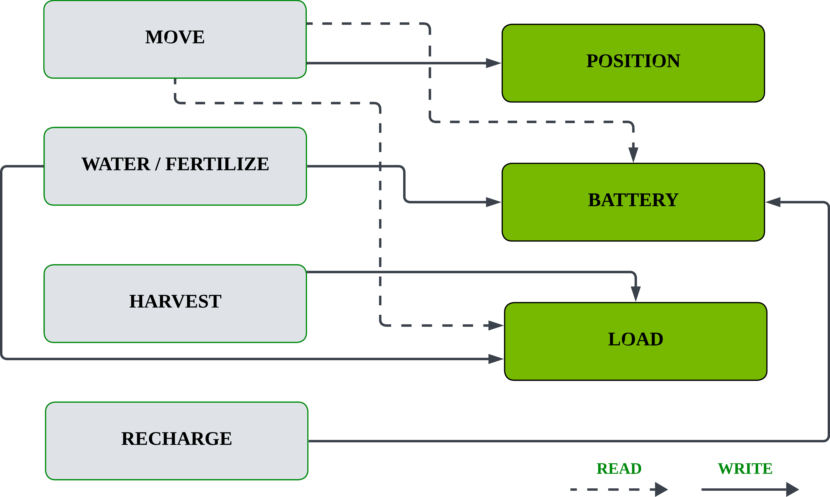
1
2
3
4
1
Problem & Domain
Design choices
Results
Reflections
Numeric fluents & the load coupling
Fluents: battery, capacity, load , energy is a hard number, not boolean states.
Move cost = edge cost + load
Water / Fertilize : - 5 units
Harvest : +5 units
Other Choices :
recharge uses assign (true reset to full, not +1).
robot-at, not at — ENHSP reserves at.
Why: only move reads load, but operations write it , so the order of jobs decides energy feasibility, not just the route.

Slide 7






1
2
3
4
1
Problem & Domain
Design choices
Results
Reflections
Processes & events: the PDDL+ core
start / stop
Action
Split each move/task : a timer gates the stop
WHY ? No durative actions,this makes time real
Discharge
Process
Battery drains Δt × (rate + load) while active.
WHY ? : continuous drain, not a fixed step cost
Recharge
Process
At the dock, +25/s — the robot must wait.
WHY : recharging costs time, like real charging.
Events
Auto
depletion: Fail at battery 0
overcharge: clip at capacity 100.
WHY ? enforce limits the planner can't violate
Terrain
Rate
flat 5/s vs muddy 15/s, load on top.
WHY ? same edge, different cost by time & load
Together: actions decide what to do; processes and events model the physics that happens on its own.

Slide 8
RESULTS
3

Slide 9
1
2
3
4
1
Problem & Domain
Design choices
Results
Reflections
Q1 : The two chosen plans
P1 — feasible on one charge
no recharge · ends 25/100
D → P1
›
monitor
›
P1 → D
›
D → P2
›
water
›
P2 → D
Watering drops the load, so the last move costs only 10 instead of 15.
P2 — recharge required
round trip > 100 · ends 5/100
D → P1
›
P1 → P3
›
fertil.
›
P3 → P1
›
P1 → D
›
Rech .
›
D → P2
›
P2 → P4
›
harvest
›
P4 → P2
›
P2 → D
The far-plot round trip needs more than 100 energy — the planner inserts the recharge (orange) on its own.
■ operation ■ recharge □ move

Slide 10
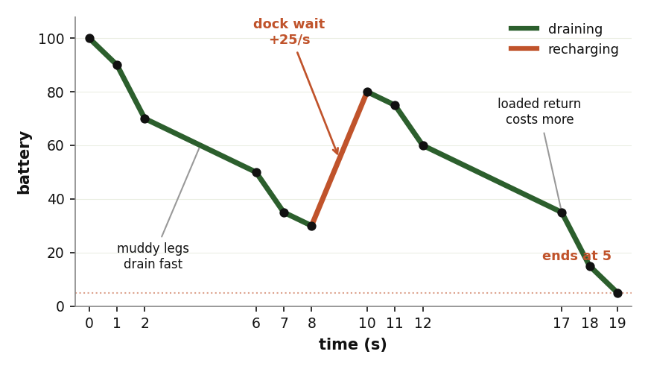
1
2
3
4
1
Problem & Domain
Design choices
Results
Reflections
Q2 Problem 2 : The recharge story (muddy mission)
The plan, step by step:
D→P1
P1→P3
Fertilize
P3 → P1
P1 → D
WAIT/charge
D → P2
P2 → P4
harvest
P4 → P2
P2 → D

Slide 11
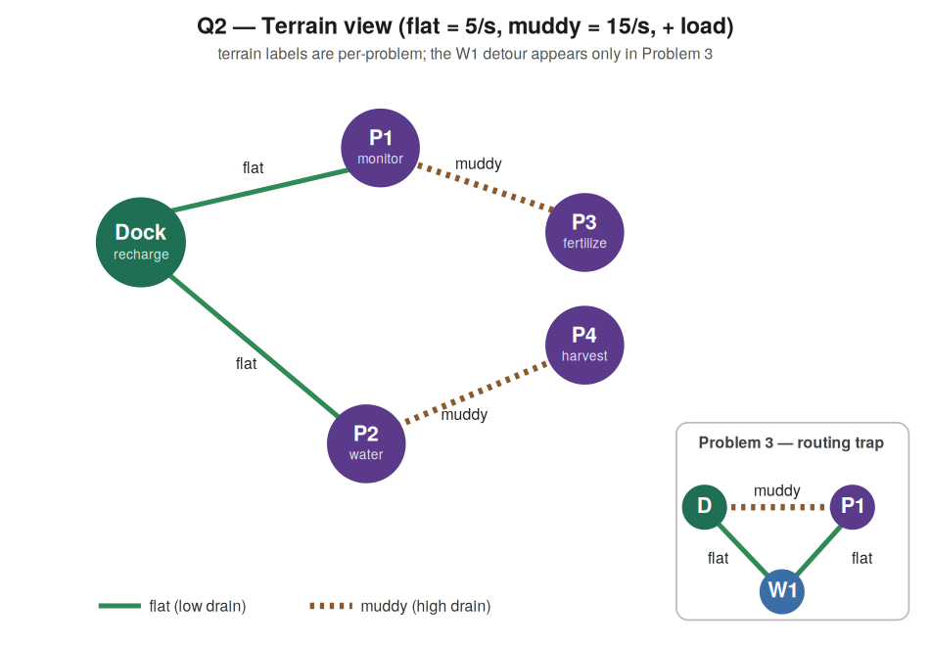
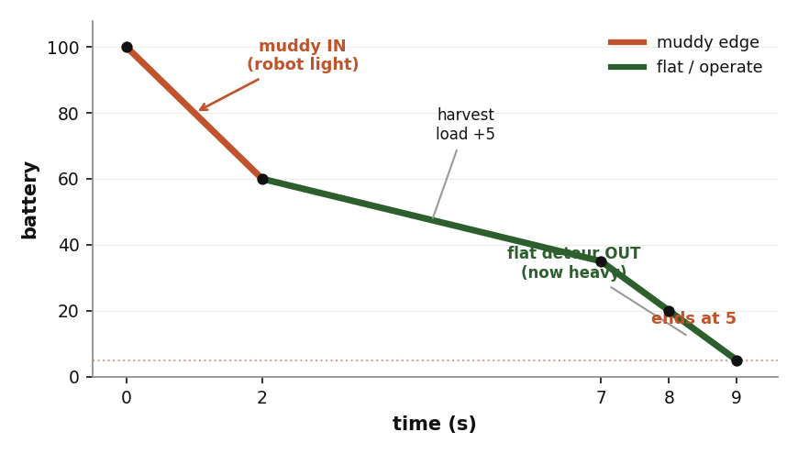
1
2
3
4
1
Problem & Domain
Design choices
Results
Reflections
Q2 Problem 3 : Load-dependent routing
Harvest P1, then return to dock. Two ways back: a short muddy edge, or a longer flat detour via W1.
The clever bit
Mud INBOUND while light (load 5).
Harvest → load 10.
Flat detour OUTBOUND now that mud would cost too much.
The field — muddy edge vs flat W1 detour (inset).
P3 battery ends at 5.
D→P1 (muddy, light)
harvest P1
P1→W1 (flat)
W1→D (flat)
Why it's the key result: the route is not chosen by distance , the same muddy edge is worth taking while light and worth avoiding while loaded. Routing and energy are one decision.

Slide 12
1
2
3
4
1
Problem & Domain
Design choices
Results
Reflections
Every problem behaved as expected
Q1 P2 — far plots
recharge inserted mid-mission
ends 5
✓
Q2 P1 — all flat
feasible on one charge
ends 45
✓
Q2 P2 — muddy
dock wait, then finishes
ends 5
✓
Q2 P3 — routing
mud in (light), detour out
ends 5
✓
Both Q1 plans validated with VAL; every continuous run matched the hand-computed energy trace. Bars show end-of-mission battery — three of four land near empty, by design.

Slide 13
REFLECTIONS
4

Slide 14
1
2
3
4
1
Problem & Domain
Design choices
Results
Reflections
Challenges, limits, next steps
Hardest part
Limitations
What I'd change
Gating continuous processes. PDDL+ has no durative actions here, so I used a start/stop + timer pattern to force each task to run its full time.
Small field (5 nodes)
time is discretized by the planner's step
a single robot
terrain is two fixed rates.
Add a continuous solar/idle drain
Multiple robots sharing one dock, and a smarter heuristic for larger fields.

Slide 15

Thank you for your attention !
Questions & discussion
Notes:
Thank you for your attention !

